Slide 1
Session – 7
Understanding Requirements

Slide 2
Need to Understand Requirements (Quick Look)
What is it?
Who does it?
Why is it important?
What are the Steps?
What is the work product?
How do I ensure that I’ve done it right?

Slide 3
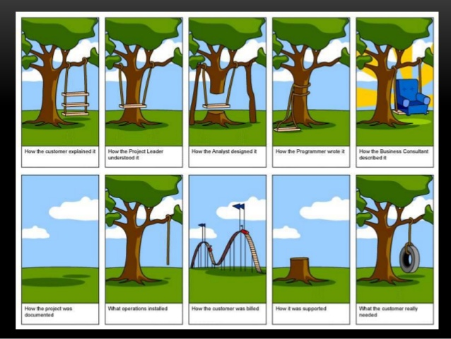


Slide 4
Types of Requirements
Broadly requirements can be categorized into
Functional
Non Functional

Slide 5
Requirement Engineering
Requirement Engineering is the process of defining, documenting and maintaining the requirements. It is a process of gathering and defining service provided by the system.

Slide 6
Stages in
Requirements Engineering
Elicitation
Elaboration
Negotiation
Specification
Validation
Requirements management

Slide 7
Contd.,
Inception—ask a set of questions that establish …
  basic understanding of the problem
  the people who want a solution
  the nature of the solution that is desired, and
  the effectiveness of preliminary communication and collaboration between the customer and the developer
Elicitation—elicit requirements from all stakeholders
Elaboration—create an analysis model that identifies data, function and behavioral requirements
Negotiation—agree on a deliverable system that is realistic for developers and customers

Slide 8
Contd.,
Specification—can be any one (or more) of the
following:
  A written document
  A set of models
  A formal mathematical
  A collection of user scenarios (use-cases)
  A prototype
Validation—a review mechanism that looks for
  errors in content or interpretation
  areas where clarification may be required
  missing information
  inconsistencies (a major problem when large products or systems are engineered)
  conflicting or unrealistic (unachievable) requirements.
Requirements management

Slide 9
Establish the Ground Work
Identify Stakeholders
A stakeholder as “ anyone who benefits in a direct or indirect way from the system which is being developed.
Recognizing multiple viewpoints
- The Marketing group
- Business Mangers
- Software Engineers
- Support Engineers
Working toward collaboration
Asking the First Questions

Slide 10
Eliciting Requirements
Requirements elicitation (also called requirements gathering) combines elements of problem solving, elaboration, negotiation, and specification. In order to encourage a collaborative , team-oriented approach to requirements gathering, stakeholders work together to identify the problem, propose elements of the solution, negotiate different approaches and specify a preliminary set of solution requirement.
Collaborative Requirements Gathering.
Quality Function Deployment
Usage Scenarios
Elicitation work products

Slide 11
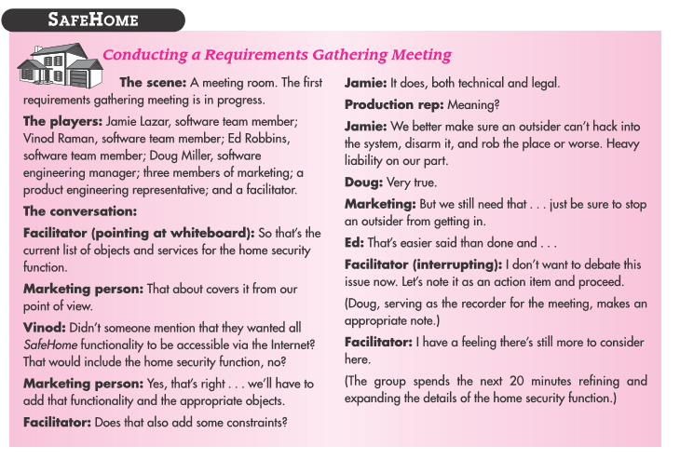
Collaborative Requirements Gathering.

Slide 12
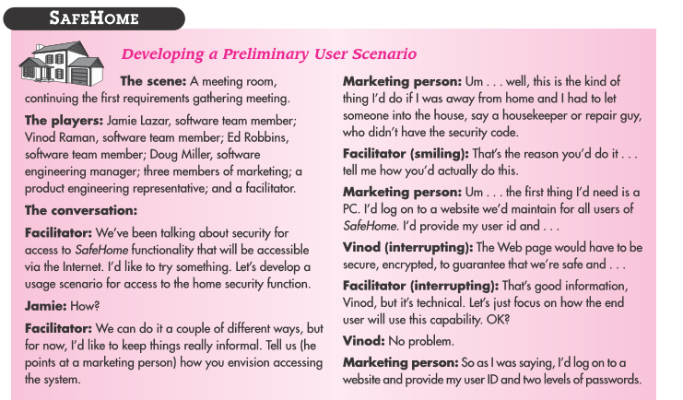
Usage Scenarios

Slide 13
Questions:
Explain the requirements engineering process with help of a diagram? And also explain the spiral model of requirements?
Explain in detail on requirements Elicitation and Analysis process?
Elaborate on requirements Discovery and view points?
What are the goals of requirements engineering process?

